Slide 1
GLACIER CHARACTERISTICS IN THE USA HTTPS://GITHUB.COM/GENESISJRUIZ/PROJECT_4_USA_GLACIERS

Slide 2
PROJECT 4 TEAM
Cruzald Boholst - aradr1
Genesis Ruiz - genesisjruiz
Kyle McDaniel - Kyle-McGitHub
Parth Pisolkar – parthpisolkar2002
Stephen Markovic - BC_SM
Zahra El Oula Kirathi - KZahraeloula

Slide 3
PROJECT OBJECTIVE
This project focuses on analyzing glacier data in the USA, utilizing various data sources and machine learning techniques to predict glacier types and visualizing USA glacier related trends such as location, area of glacier, elevation and temperature.

Slide 4
OVERVIEW
Data Collection
We will collect data from the National Snow and Ice Data Center (NSIDC) and NOAA..
Data Preprocessing
Clean and preprocess the data.
Exploratory Data Analysis (EDA)
We will perform EDA to understand the distribution and relationships within the data. This will involve creating visualizations such as scatter plots, histograms, and box plots.
Statistical Analysis
Employ statistical methods. This includes correlation analysis, regression analysis, and
hypothesis testing to draw meaningful insights from the data.
Model Building
Build a predictive model using machine learning algorithms. This model will help us predict future trends based on the data we have.
Dashboard
Create a dashboard to present our data and findings. The dashboard will allow users to interact with the data, enhancing their understanding of our analysis.
Interpretation and Conclusion
Finally, we will interpret our findings and draw conclusions. Create a PowerPoint

Slide 5
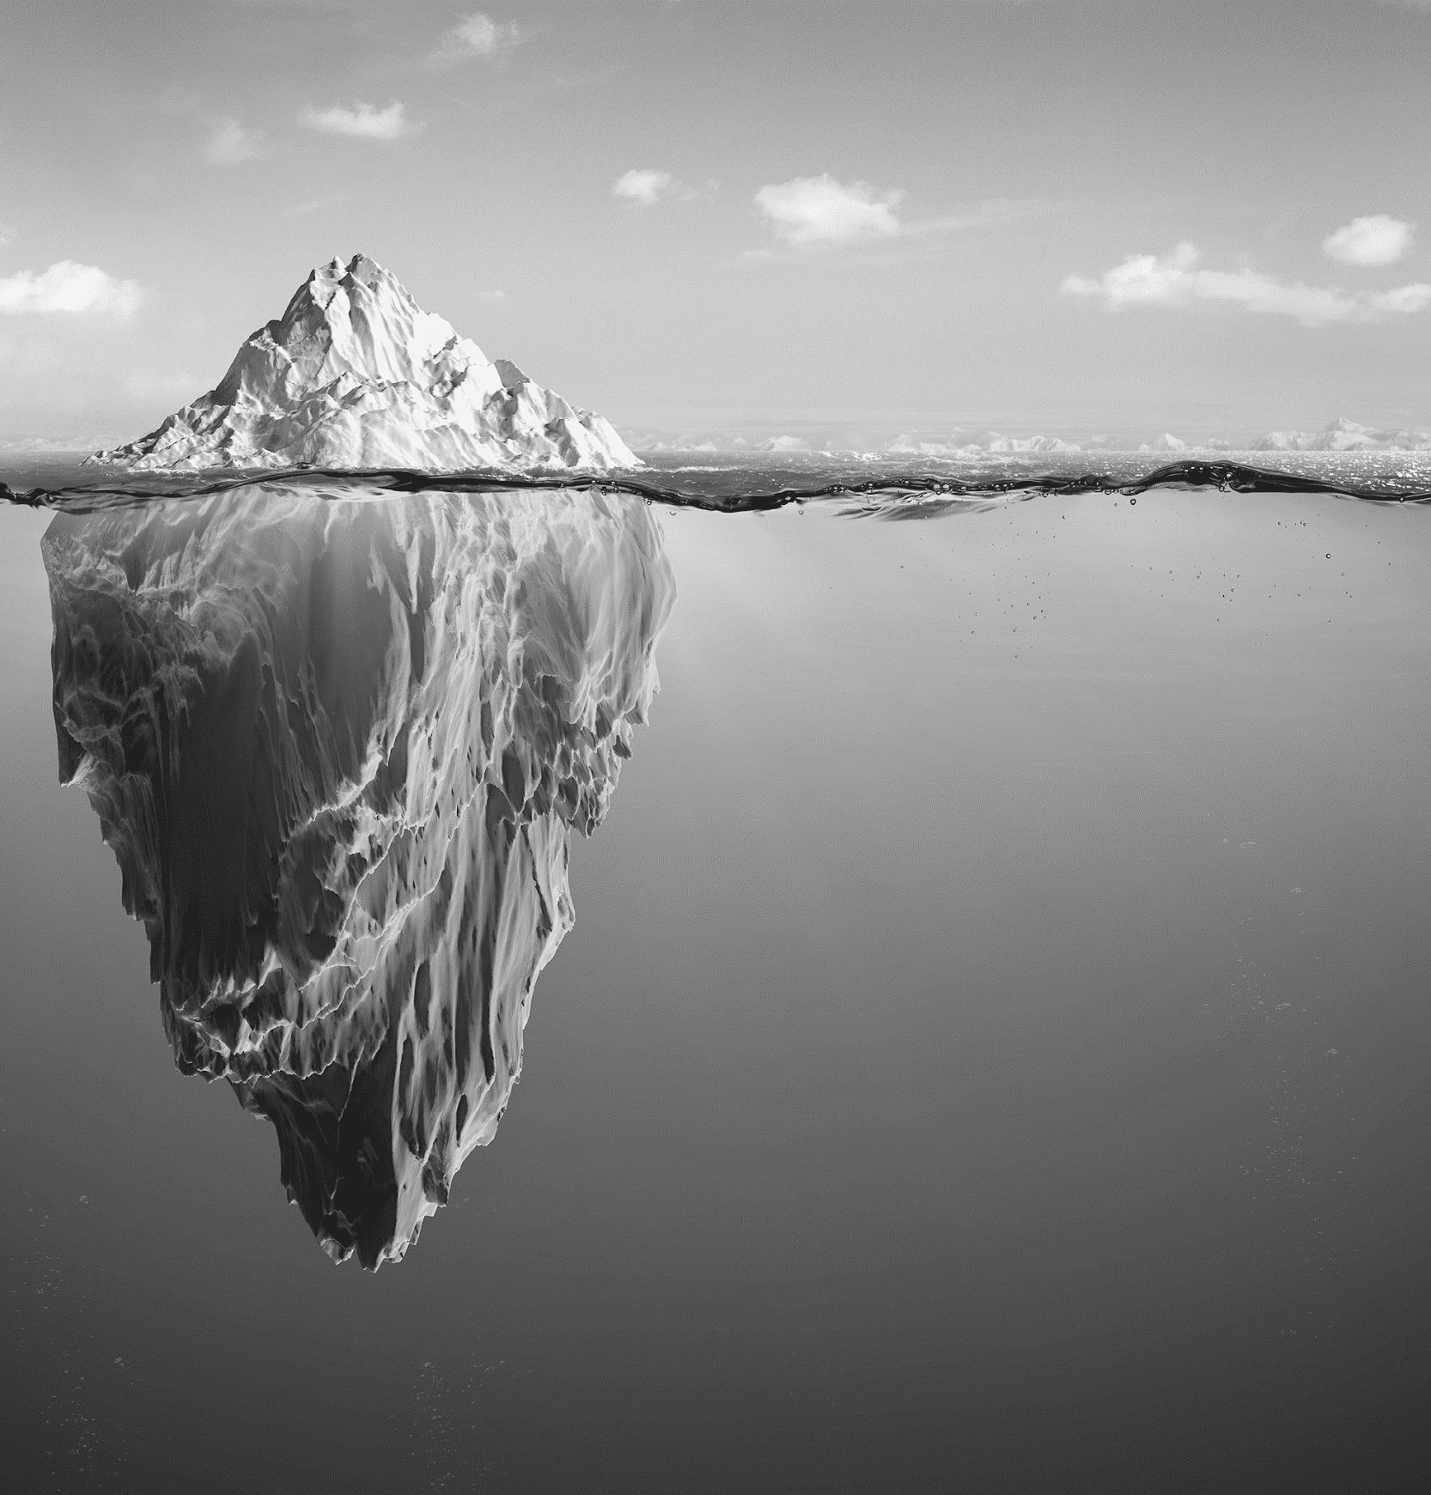
DATA SELECTION

Slide 6
Data Sources & Characteristics
National Centers for Environmental Information
NOAA
Glacier data tracking characteristics of various glaciers throughout the United States
Data points tracked:
Glacier size
Glacier type
Location (longitude & latitude)
Time duration of data points
Link: https://ncei.noaa.gov/access/monitoring/climate-at-a-glance/county/time-series
Temperature data tracking throughout the United States
Data points tracked:
Average Temp
Location (longitude & latitude)
Link: https://www.ncei.noaa.gov

Slide 7
DATA PREPARATION

Slide 8
Data Modeling
National Centers for Environmental Information
Separation: Numerical data was separated from categorical data.
Dummy Variables: Created dummy variables from categorical data and merged them back.
Splitting: Data was split into testing and training sets.
Model Initialization: Initialized RandomForestClassifier and trained the model.
Prediction: Initially predicted glacier existence, but shifted to predicting glacier types due to poor initial results.
Performance: Achieved an R-square score of 93% for predicting glacier types.

Slide 9
Glacier Dashboard
Interactive dashboard showcasing data analysis performed on the data sets.

Slide 10
Findings & Conclusion
Limitations and Recommendations:
Geographical Scope: Data is limited to the USA, primarily Alaska and northern parts.
Feature Imbalance: Uneven amount of features compared to documentation.
Recommendation: Use global data for a more comprehensive analysis.
Conclusion:
This project showcases the process of data cleaning, modeling, and visualization to analyze glacier data in the United States. The model accurately predicted glacier type. The model demonstrated high accuracy in predicting glacier types. Visual representations, integrating variables such as temperature, area, geographical location, and elevation, provided significant insights into glacier trends. To further enrich these findings, integrating higher-quality data, additional environmental factors, and expanding the analysis to include global data over extended periods could deepen our understanding of glacier dynamics and enhance our predictive capabilities regarding their formation and evolution.

Slide 11
THANK YOU

